Slide 1


Fitness Center Case Study
Exploring Customer Retention
& Revenue Growth Strategies
Team 3: Vaishnavi Kokadwar, Jane Lee, Devi Mahajan, David Wei, Sarah Xia, Terry Zhuang
University of Chicago
Nov 6, 2024
Notes:
Hi everyone! Thank you all for being here today.
This is Team 3. I’m XXX….. We’re excited to present our analysis on customer retention and revenue growth strategies for fitness centers.

Slide 2


Executive Summary
Executive Summary
Business Problem
Client Goals
&
Business Plan
Identify the driving factors behind customer churn to develop effective strategies for retention and revenue enhancement:
Customer Identification: Who are the members who are leaving? Are there specific demographics or behavioral characteristics that these customers share?
Churn Motivation: Why they choose to drop off? Are there common themes in their feedback regarding satisfaction, service quality, or external factors?
Our client, a chain of fitness centers, is facing a significant challenge with customer churn. Fitness Center has yet to identify effective solutions to mitigate these losses
Potential Retention Strategies
Customer Behaviour: Focus on improving usage frequency of enrolled members and encouraging digital payments
Membership Features: Consider flexible pricing options and incentivize higher down payments to increase perceived investment
Page 1
Notes:
As we know, the fitness industry has become increasingly competitive, with many gyms struggling to retain members beyond the first few months.
Our client also face this challenge - customer churn. So, our team took a data-driven approach to explore the root causes of member attrition and to identify strategic opportunities to increase long-term engagement and revenue.

Slide 3
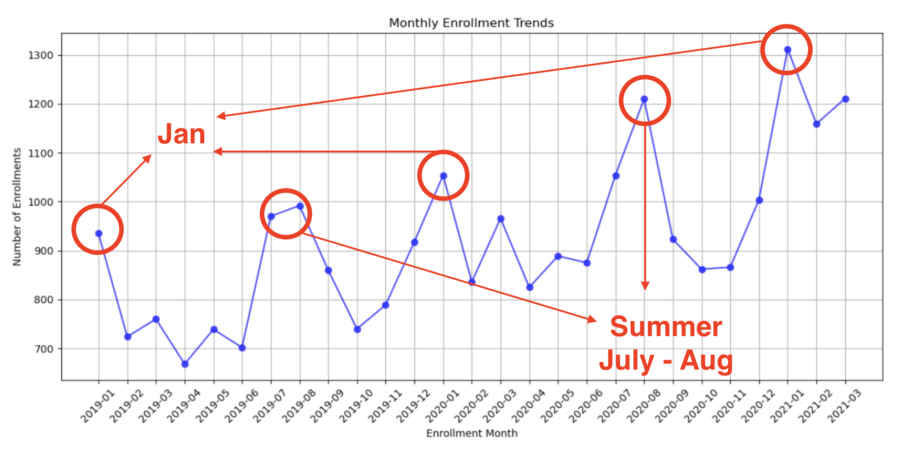
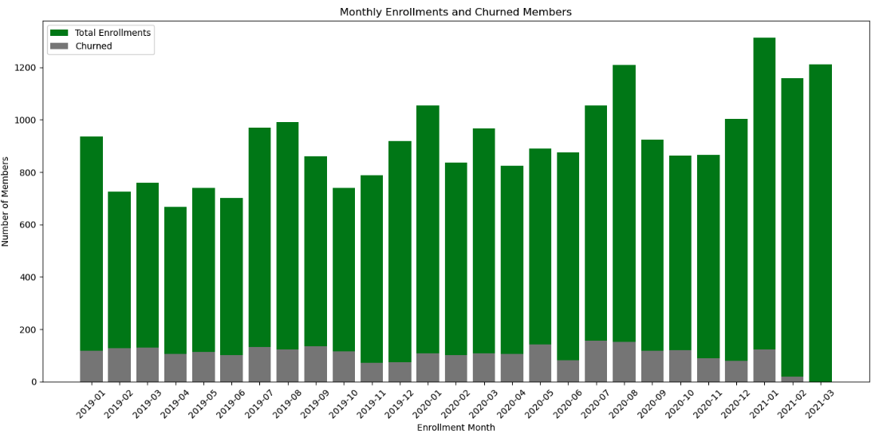
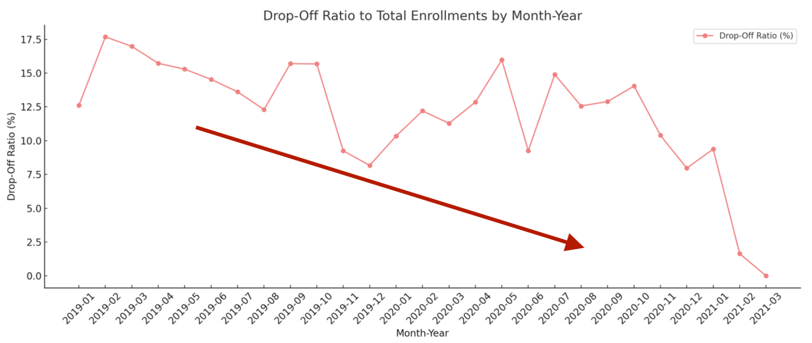
A clear seasonal pattern with peak enrollments during January-February and a secondary increase in June-September.
Business Problem >> Findings & Analysis >> Data Assessment >> Modeling Approach >> Preliminary Results >> Strategy Recommendations
Business Situation: Enrollment Trends Reveal Seasonal Peaks with Persistent Customer Churn Challenges Throughout the Year
Monthly Enrollment Trends
Monthly Churn Distribution
The fitness center's business operations are healthy, with enrollment numbers consistently increasing each year and each month. The average monthly enrollment jumped from 816 to 947 per month from 2019 to 2020.
Enrollment peaks in January and during the summer season, with 20-25% more people joining compared to regular months. The January increase is likely driven by New Year's health resolutions, while the rise in July and August is motivated by the desire to manage one's physique for the warmer season.
Overall, our client’s fitness center is performing well, so the focus will now shift to improving customer retention—finding strategies to keep more members engaged and committed.
The fitness center market demonstrates a strong growth trend, reflecting increasing public awareness and demand for health and fitness services.
Although a consistent number of members continue to drop off, this drop-off rate remains stable, making it feasible to identify these members and develop targeted retention strategies.
Monthly drop-off counts are stable
Improvements in retention efforts
Summer months continue experience high drop-off rates
Page 2
Notes:
Well, we can take a look at our current business situation, include both our clients business center, current business operation condition, and also the challenges or the business problem our clients are facing about. So let's look at the photograph, which shows the monthly enrollment trends. It keeps increasing for each year, and each month is a good trend, which means, like in the following years, there will still be the increasing number of enrollments to join our membership. The average monthly enrollment jumped from 816 to 947 per month from 2019 to 2020, now YTD average is at 1227 for the first quarter of 2021. And there especially some interesting months, like the January, the beginning of the year, and during the summer season, July or August, people have more motivation to join our membership. And this is a health trend. So like, which means like, there will still be more and more people choose to join our membership in our clients fitness fitness center. So we'll take a look at the challenges our clients are concerned about the customer chain, which means the sum of the membership at some point of the year. You can take a look at this graph, the gray one shoes, like, how many number of people choose to drop off at some point of the year is keep, like constant. So which means, like, our fitness center keep losing the members for each year. So this is kind of the problem our clients are facing about and want to address, like, who are the How can we deal this? Can solve the problem, and we all take a detail to look at this and to find the characteristic of the customers, the behavior of our customers, and even like the memberships characteristic.
—----
Graph 1 (left): The graphs illustrate monthly enrollment trends, showing a clear seasonal pattern with peak enrollments during January-February and a secondary increase in June-September. This pattern suggests that fitness center memberships are influenced by seasonal fitness goals, such as New Year’s resolutions and preparation for summer.
The fitness center market demonstrates a strong growth trend, reflecting increasing public awareness and demand for health and fitness services. As shown in the graph, monthly membership enrollments are steadily rising. Although a consistent number of members continue to drop off, this drop-off rate remains stable, making it feasible to identify these members and develop targeted retention strategies.Although a consistent number of members continue to drop off, this drop-off rate remains stable, making it feasible to identify these members and develop targeted retention strategies.
It’s time to capture the opportunity of the increasing fitness center market increasing trends - adopt loyal customers, attract more customers, mitigate the number of drop-off members.

Slide 4
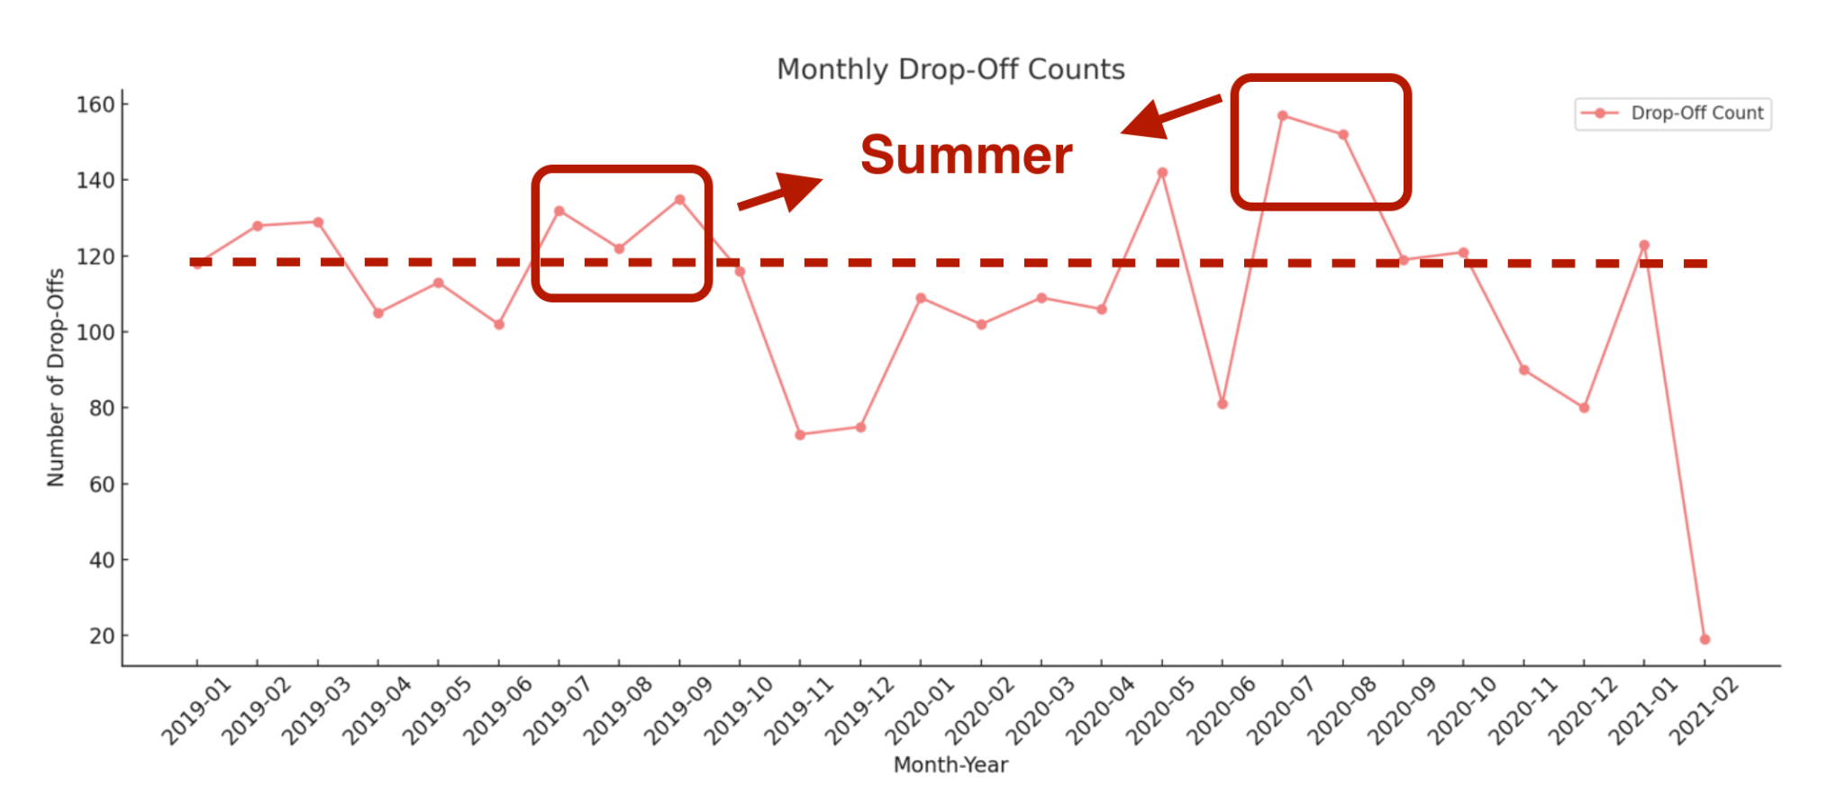
Business Problem >> Findings & Analysis >> Data Assessment >> Modeling Approach >> Preliminary Results >> Strategy Recommendations
Enrollment Timing Impacts Retention: Constant Membership Drop-Offs, with Especially High Rates for Members Enrolling in January and Summer
Monthly Drop-Off Counts
Observations
For a clearer view, see the chart to the left: on average, around 120 members cancel their membership each month, with summer enrollees showing a higher tendency to quit.
Enrollment timing plays a role in retention: members who enroll in January or during the summer season are more likely to discontinue their membership.
Page 3

Slide 5
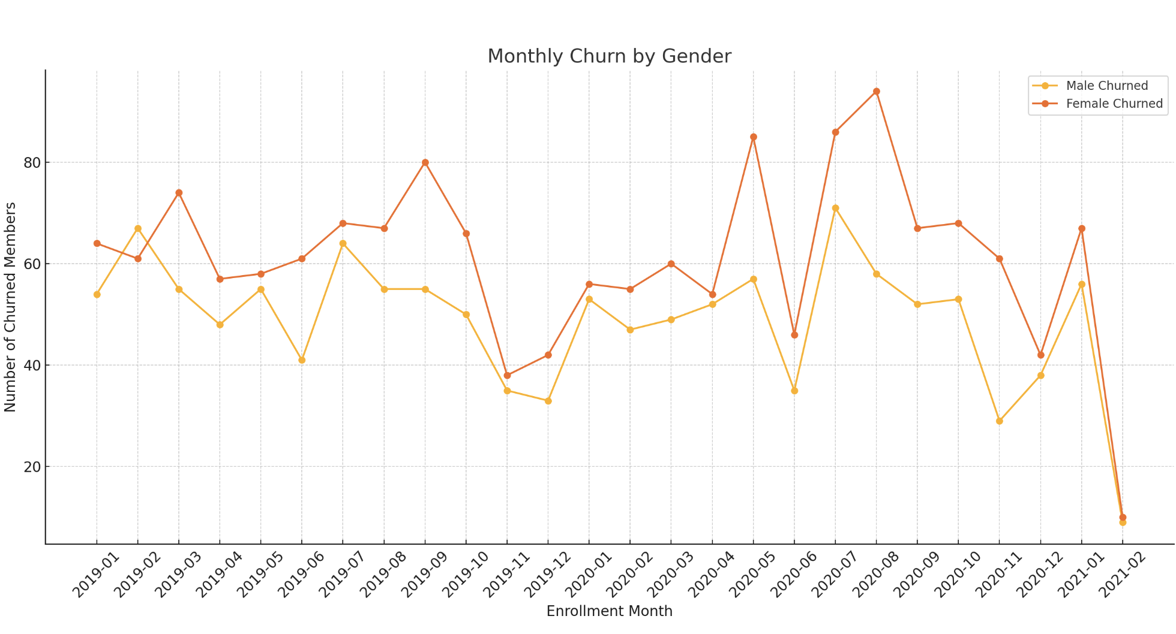
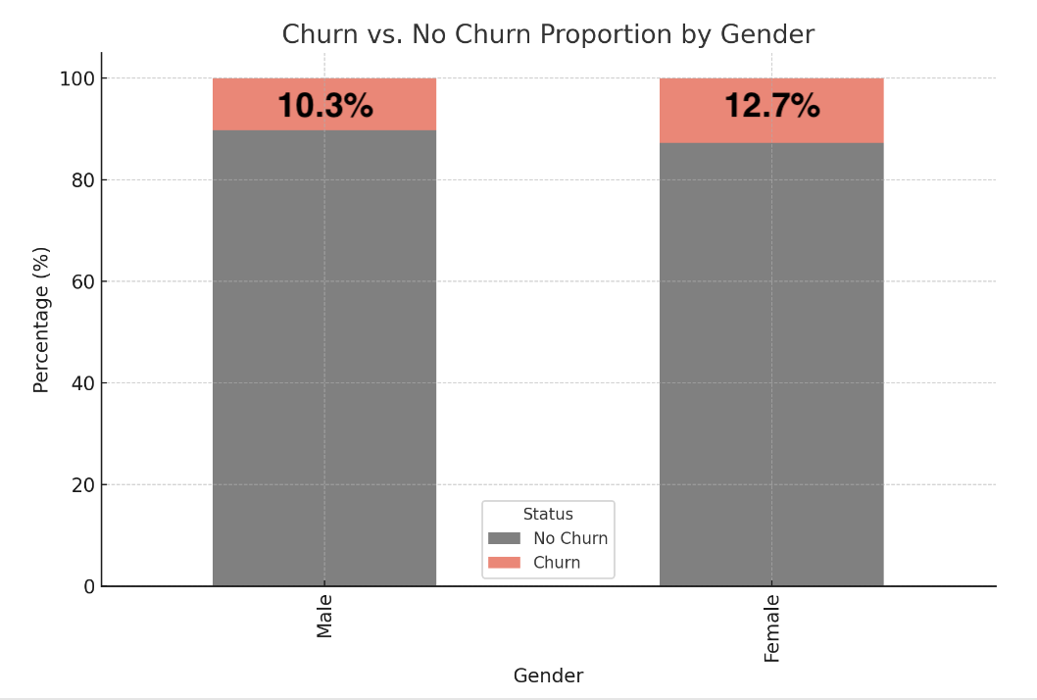


Business Problem >> Findings & Analysis >> Data Assessment >> Modeling Approach >> Preliminary Results >> Strategy Recommendations
Customer Characteristics: Retention Analysis Reveals Gender-Neutral Churn Patterns, Highlighting the Need for Broader, Non-Gender-Specific Retention Strategies
Monthly Churn By Gender
Churn V.S. No Churn Proportion By Gender
Customer Gender Segmentation
55.5%
44.5%
Page 4
Notes:
Based on the dataset we get from you (Client - fitness center): Price, Downpayment, month due, age, usage frequency, payment type, gender ..
new copy: (done? 后面加了点，但其实时间限制下没必要说的东西）
The most obvious demographic factor to look at is the customer’s gender. From the left graph, we can see the red line, representing female customer churn number, is steadily slightly above the male’s.
The right bar graph shows a more direct comparison between the aggregate churn rate of male and female, (The male churn rate is 10.3%, and the female churn rate is 12.7%)
and on average, we see females have a 2.5% higher churn rate.
(We did a chi-squared test on this difference in churn rate, and found it to be statistically significant, with a very small p-value close to 0, 1.78x10^(-9))
(This suggests a possible inherent difference between female and male customer behavior with respect to churn, which is information we can use while developing targeted strategy for marketing or customer retention. However, we should also note despite this difference being statistically significant, whether this 2.5% difference is economically significant is yet to be determined/determined by you guys, the client.)

Slide 6
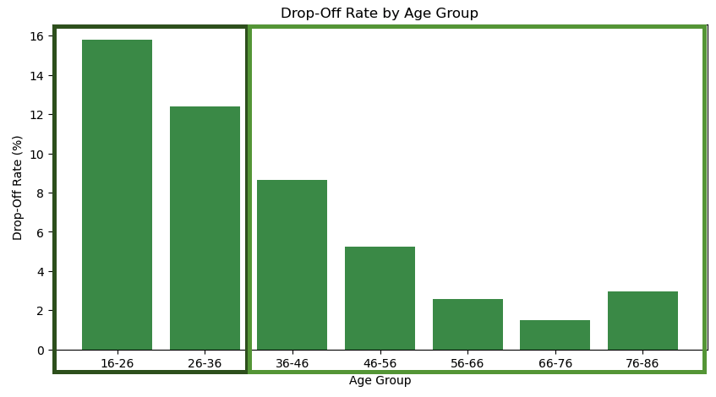




Business Problem >> Findings & Analysis >> Data Assessment >> Modeling Approach >> Preliminary Results >> Strategy Recommendations
Customer Characteristics: Younger Members Show Higher Drop-Off Rates, Particularly When Enrolled During Peak Periods, While Older Members Demonstrate Greater Stability and Commitment
Young Adults
16-26
Joining during peak times - motivated by enthusiasm or desire for quick changes;
Lack long-term commitment
26-36
Middle-Aged Working Class
Drop-off Rate by Age Group
36-46
Slightly more stable;
Drop-off due to Work-related stress or lack of time
46-56
AGE
56-66
76-86
Middle-to-Older Adults
66-76
Drop-off rates are quite low;
Focus on maintaining health rather than dramatic physical changes
Members aged 16-36 exhibit the higher churn rates, likely driven by short-term motivations.
1
Members aged 36 and above tend to show more stability, suggesting a stronger commitment to long-term fitness goals.
2
Older Adults
Conclusion
Recommended by doctors
Personal commitment to wellness
Page 5
Notes:
From this chart, it is evident that individuals aged 36 and older tend to be more stable, with about 20 people dropping off each month. In contrast, those under 36 are fickler and more prone to dropping off. However, it is noticeable that young members who enroll during the off-peak season are less likely to drop off. This may be because younger individuals who sign up at the beginning of the year or during the summer are often motivated by enthusiasm to change themselves but find it difficult to maintain their commitment, leading to drop-offs. In contrast, younger members who enroll during the off-peak season are more likely to have made a deliberate decision and have a plan, making them less likely to drop off.

Slide 7
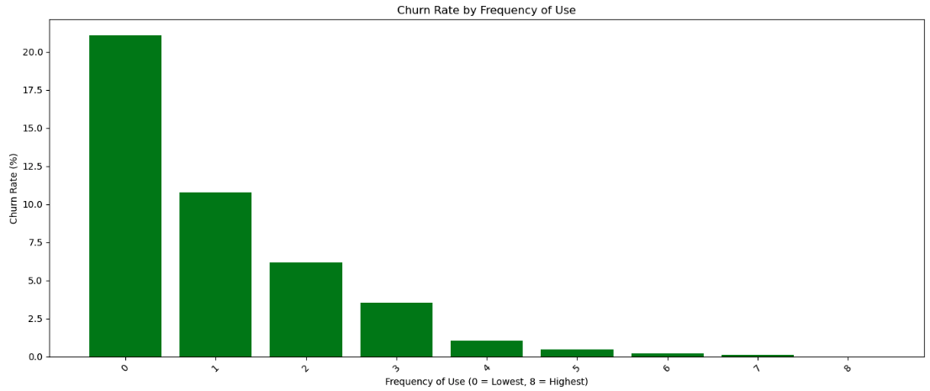
Business Problem >> Findings & Analysis >> Data Assessment >> Modeling Approach >> Preliminary Results >> Strategy Recommendations
Customer Behaviors: Frequent Usage Drives Higher Retention, with Increased Usage Frequency Significantly Reducing Churn Rates
Churn Rate by Frequency of Use
Use Frequency
Inverse Correlation between use frequency and churn rate - with usage levels >= 4, churn rates stabilize and remain low
1
Frequent users may find more value in their membership, contributing to satisfaction
2
Regular use may help members build fitness habits, increasing their commitment to stay enrolled
3
Encouraging members to increase usage frequency → Reducing churn rate
4
Conclusion
Page 6
Notes:
This analysis suggests that usage frequency is a strong predictor of member retention.

Slide 8
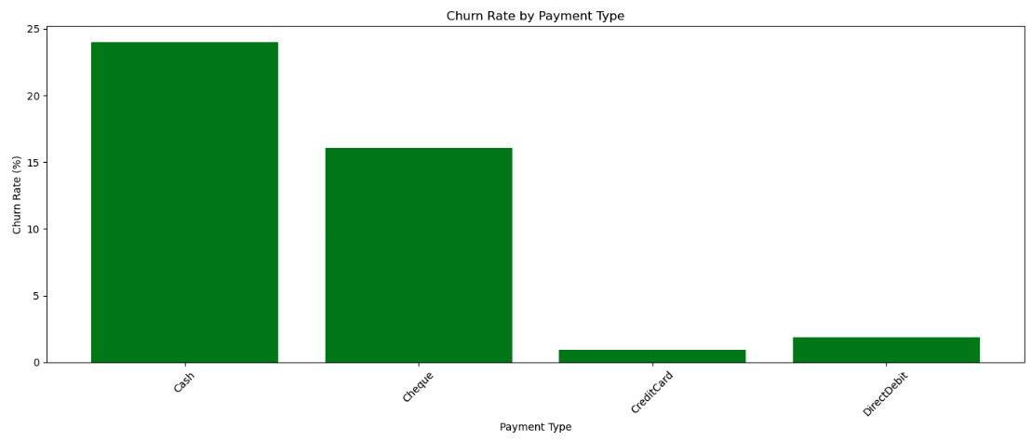
Business Problem >> Findings & Analysis >> Data Assessment >> Modeling Approach >> Preliminary Results >> Strategy Recommendations
Customer Behaviors: Addressing Retention Barriers for Cash and Cheque-Paying Members by Transitioning to Digital Payments to Reduce Churn
Churn Rate by Payment Type
Payment Method
Cash-paying members exhibit the highest churn rate (~20%)
1
Cash Users: Older or financially constrained, more price-sensitive, and likely to seek cheaper alternatives.
2
Cheque Users: Generally more affluent but may be indifferent to membership cost.
3
Conclusion
Cash and cheque payments lack auto-renewal, increasing the risk of membership lapses → Encourage transition to digital payments to reduce renewal barriers and improve retention
Page 7
Notes:
From this chart, it is evident that individuals aged 36 and older tend to be more stable, with about 20 people dropping off each month. In contrast, those under 36 are fickler and more prone to dropping off. However, it is noticeable that young members who enroll during the off-peak season are less likely to drop off. This may be because younger individuals who sign up at the beginning of the year or during the summer are often motivated by enthusiasm to change themselves but find it difficult to maintain their commitment, leading to drop-offs. In contrast, younger members who enroll during the off-peak season are more likely to have made a deliberate decision and have a plan, making them less likely to drop off.

Slide 9
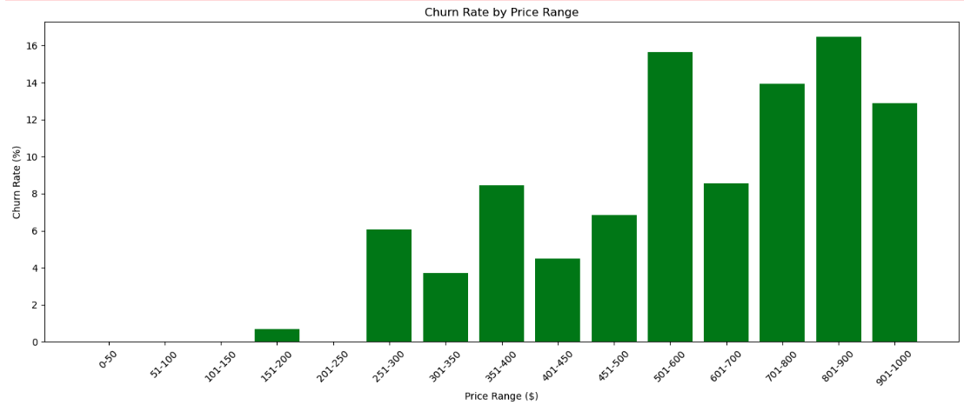
Business Problem >> Findings & Analysis >> Data Assessment >> Modeling Approach >> Preliminary Results >> Strategy Recommendations
Membership Features: Understanding the Impact of Price Sensitivity on Premium Member Retention by Balancing Expectations and Financial Pressures
Churn Rate by Price Range
Price
Increased Churn in Higher-Priced Plans: Higher-priced members show elevated churn rates.
Heightened Expectations: These members often expect higher service quality and added value, leading to dissatisfaction if unmet.
Conclusion
Retention Strategy: Enhance perceived value for higher-priced plans and consider flexible pricing options to alleviate financial strain.
Page 8
Notes:
From this chart, it is evident that individuals aged 36 and older tend to be more stable, with about 20 people dropping off each month. In contrast, those under 36 are fickler and more prone to dropping off. However, it is noticeable that young members who enroll during the off-peak season are less likely to drop off. This may be because younger individuals who sign up at the beginning of the year or during the summer are often motivated by enthusiasm to change themselves but find it difficult to maintain their commitment, leading to drop-offs. In contrast, younger members who enroll during the off-peak season are more likely to have made a deliberate decision and have a plan, making them less likely to drop off.

Slide 10
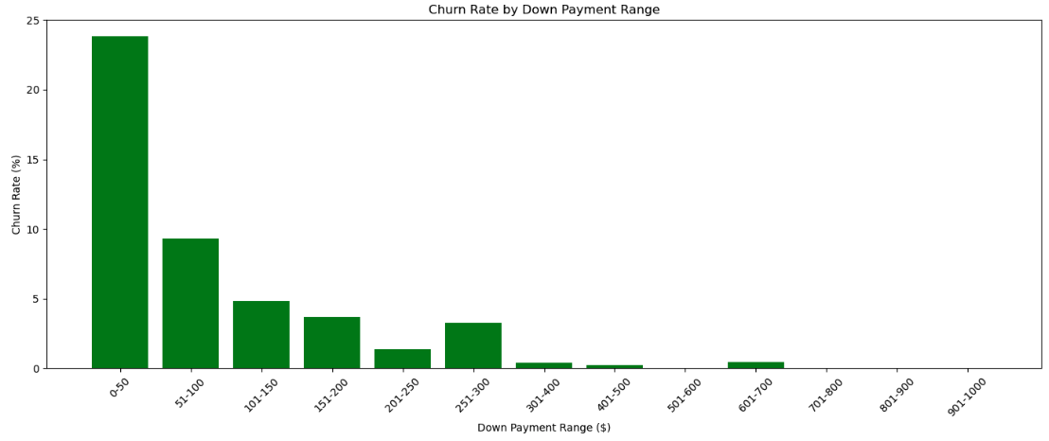
Business Problem >> Findings & Analysis >> Data Assessment >> Modeling Approach >> Preliminary Results >> Strategy Recommendations
Membership Features: Strengthening Member Commitment through Higher Upfront Investments and Leveraging Down Payment Strategies to Boost Retention
Churn Rate by Down Payment
Down Payment
Higher Down Payments = Better Retention: Members with larger down payments tend to have lower churn rates, indicating greater commitment.
Low Down Payment, High Churn: Members paying under $50 upfront show significantly higher churn rates.
Conclusion
Retention Strategy: Encourage higher initial payments by offering incentives or benefits for larger down payments, reinforcing commitment.
Page 9
Notes:
From this chart, it is evident that individuals aged 36 and older tend to be more stable, with about 20 people dropping off each month. In contrast, those under 36 are fickler and more prone to dropping off. However, it is noticeable that young members who enroll during the off-peak season are less likely to drop off. This may be because younger individuals who sign up at the beginning of the year or during the summer are often motivated by enthusiasm to change themselves but find it difficult to maintain their commitment, leading to drop-offs. In contrast, younger members who enroll during the off-peak season are more likely to have made a deliberate decision and have a plan, making them less likely to drop off.

Slide 11
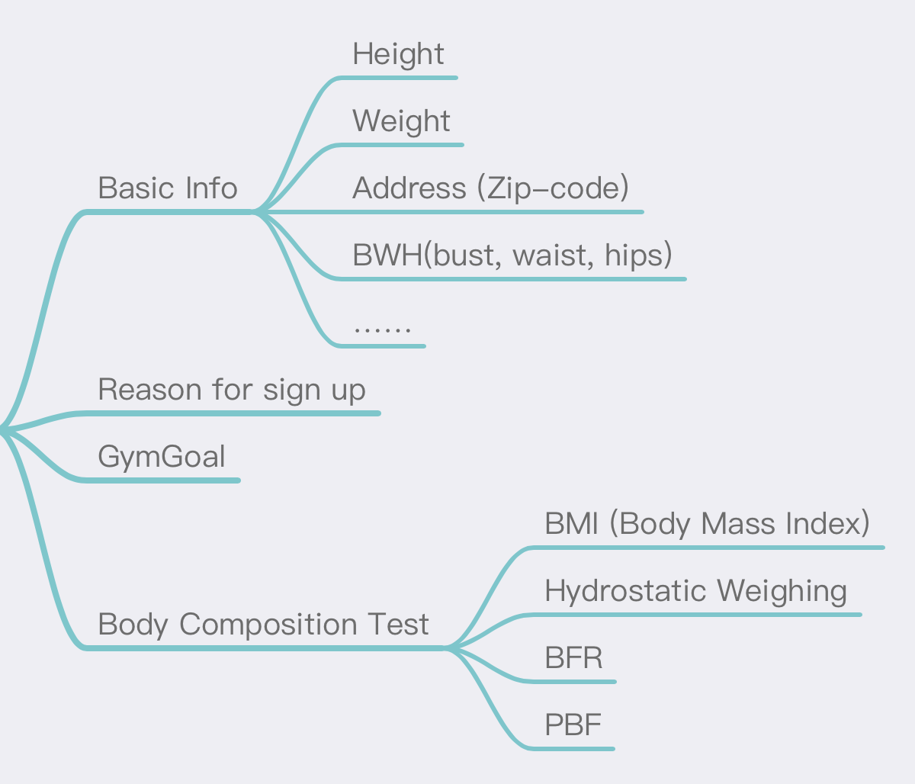
Business Problem >> Findings & Analysis >> Data Assessment >> Modeling Approach >> Preliminary Results >> Strategy Recommendations
Data Assessment: Evaluating Data Quality and Enhancing Database Structure to Support Membership Retention Analysis
The ‘enrolldt’ variable was not in date format
The meaning of the 'monthdue' variable is unclear.
There are entries with ages listed as 0 or 99 in the dataset.
The dataset only indicates the enrollment date, but it doesn’t include the drop-off date.
Existing Data
Rebuild Database to Store Data (MySQL)
Membership Price
A gym survey can be designed for collecting customer general information
Complete by coach/service staff or by the customers
Survey Length: 5 mins
We noticed varying membership prices in the data. Could you clarify what factors determine these prices? What types of membership packages are currently available, and is there potential to customize packages based on different user needs in the future?
Further Requirements
Feedback Data
Is there any available user feedback data? Insights into why members join or leave would be invaluable for understanding and addressing churn.
Page 10

Slide 12




Business Problem >> Findings & Analysis >> Data Assessment >> Modeling Approach >> Preliminary Results >> Strategy Recommendations
Modeling Approach: Logistic Regression Model - We Chose The Logistic Regression Model For The Following Reasons:
INTERPRETABLE
Produces interpretable results that allow us to investigate causes of churn
VARIED DATA TYPES
Allows for diverse data types and variables to be incorporated
FAST AND CHEAP
Runs at high speeds with less computational power required
Page 11
Notes:
Why logistic regression? - interpretable - strong model for churn prediction - helps to identify which factors contribute to churn

Slide 13






Business Problem >> Findings & Analysis >> Data Assessment >> Modeling Approach >> Preliminary Results >> Strategy Recommendations
Modeling Approach: Analyzing Key Factors Driving Customer Churn to Inform and Shape Our Logistic Regression Model for Improved Retention Strategies
 | Age Group | Younger members (ages 16-26) tend to churn at higher rates, likely due to short-term fitness motivations. | As age group increases, churn likelihood decreases, with older members showing more stability and commitment.
 | Price | Higher membership prices are associated with increased churn rates. | As price increases, churn likelihood tends to increase, possibly due to higher expectations and financial constraints.
 | Down Payment | Members with higher down payments show lower churn rates, suggesting stronger initial commitment. | As down payment increases, churn likelihood decreases, as members who invest more upfront are more likely to stay.
 | Usage Frequency | Lower usage frequency correlates with higher churn rates, implying disengagement. | Higher usage frequency decreases churn likelihood, indicating that engaged and frequent users are more likely to retain.
 | Payment type | Members who pay with cash/cheques have higher churn rates, possibly lack of recurring commitment or convenience | Cash and cheque payments increase churn likelihood, while automated payments (credit card, direct debit) reduce it.
Key Factors Driving Churn Rate
Page 12
Notes:
Why logistic regression? - interpretable - strong model for churn prediction - helps to identify which factors contribute to churn

Slide 14
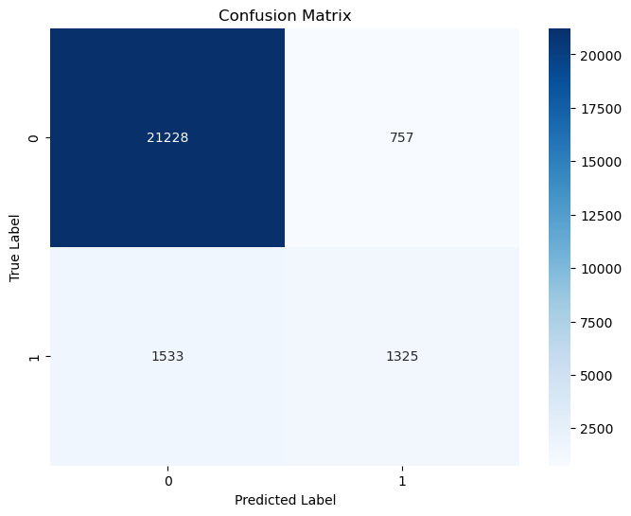
Business Problem >> Findings & Analysis >> Data Assessment >> Modeling Approach >> Preliminary Results >> Strategy Recommendations
Preliminary Results: Logistic Regression Model
CONFUSION MATRIX
TRUE POSITIVES: 1325
FALSE POSITIVES: 757
TRUE NEGATIVES: 21228
FALSE NEGATIVES: 1533
ACCURACY
91%
PRECISION (CLASS 1)
62%
F1 (CLASS 1)
54%
RECALL (CLASS 1)
48%
Page 13

Slide 15
Business Problem >> Findings & Analysis >> Data Assessment >> Modeling Approach >> Preliminary Results >> Strategy Recommendations
Strategy Recommendations: Leveraging Logistic Regression Modeling to Identify At-Risk Members and Implement Personalized Engagement Actions
Different Membership Card Choices
Fitness Center Activities
Based on customer needs, behavior and actions - What does the customer want?
Long-term membership
Short-term membership
Self-practise
Need fitness instructor
With friends
Encourage programs:
Earn points through consistent visit, and the points can be used to redeem for the next renewal
Other membership only activities, including group classes, and limited private sessions
With logistic regression model, predicting cancellation risk, trigger necessary alerts at a set threshold, and take retention actions while continuously refining the model with new data
Advertisement
APP
New advertisement approaches:
Different ADs to do in January, Summer Season and regular months
Collaborate with Apartments
Collaborate with Companies
Application for better user experience:
Fitness centers’ status tracking:
number of people present, suggest customers visit-time based on traffic
Membership management one stop shop
Page 14

Slide 16
THANK
YOU

Slide 17






Business Problem >> Findings & Analysis >> Data Assessment >> Modeling Approach >> Preliminary Results >> Strategy Recommendations >> Appendix
Client Questions：Key questions raised to gather additional information required for conducting a more comprehensive data analysis.
Priority
What retention strategies have been used in the past and how effective it was?
What short-term and long-term goals that the client look forward to achieve?
Are there any key decision-making timelines we should be aware of?
Availability of additional data might be useful (income level, location, etc) or external third party data
Customer feedback data including their user experience, reason for dropout, etc.
Can you elaborate on the various data collection methodologies employed across different branches of your fitness centres? How do these methodologies impact data quality, consistency, and storage capacity?
Is it possible to access historical data before 2019 to enhance our understanding of long-term trends and seasonality patterns?
Is personalized training available to members, and if so, what is the associated cost structure?
Additional Concerns
Page 1

